Slide 1
Local Agency Formation Commissions
Law, Policy and Practice
Plumas Local Agency Formation Commission
  December 14, 2015

Slide 2
LAFCo’s Function
Implement State Policy on Local Agency Boundaries
Oversee --
  Creation of New Agencies
  Boundary Changes
  District Services
  Extensions of Services Outside Agency Boundaries

Slide 3
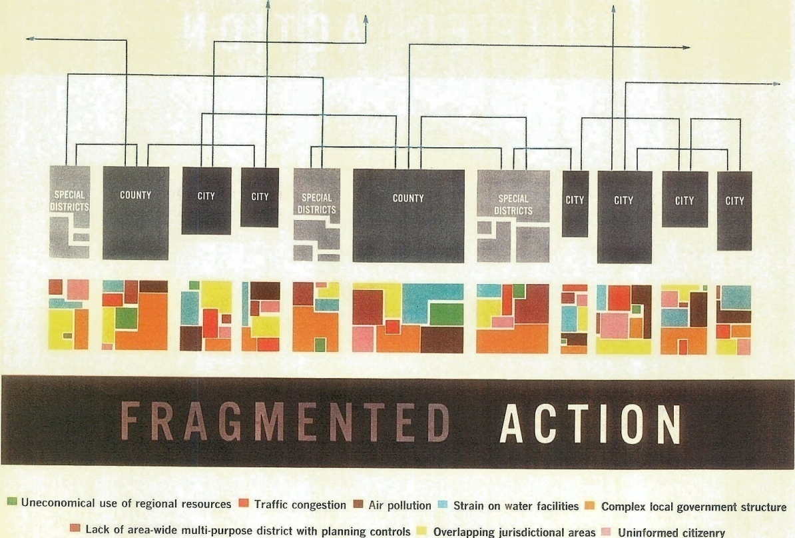
Why LAFCOs Came About
Post World War II population and housing boom in California led to:
  Scramble to finance and extend services
  City annexation "wars," and proliferation of limited purpose special districts
In 1959, the Governor’s Commission on Metropolitan Area Problems was established and issued a report identifying problems and outlining recommendations.

Slide 4
Lofty Goals -- Legislative Direction
From: California Legislature
To: LAFCo
Promote Orderly Growth and Development
Discourage Urban Sprawl
Preserve Open Space and Prime Agricultural Lands
Efficient Extension of Government Services
PS – Consider Provision of Housing for Persons and Families of All Incomes, as well as environmental justice, adequate water and Regional Transportation Plans

Slide 5
What the Courts have said
LAFCO is engaged in the pursuit of an overriding State purpose
State laws fully occupy the field
LAFCO is quasi-legislative; limited legal challenge to LAFCO decisions
LAFCO is independent, not part of County Government
LAFCO is the ‘Legislature’s watch dog’ for governmental efficiency
Cannot directly regulate land use, but must consider the impacts of land use in its determinations
LAFCO appoints an Executive Officer to conduct its day to day business

Slide 6
What the Grand Juries have said....
LAFCO “was created by State Legislation to provide guidance and a legal check....... and has ultimate authority to approve, condition or deny each project”
“LAFCo has a limited parameter of responsibility, but within that realm, has enormous power”
“We see such authority causing inherent and perhaps necessary resentment, even animosity”

Slide 7
Legislative History
                1963 – LAFCos Created
                1965 – District Reorganization Act; Knox-Nisbet Act
                1977 - Municipal Organization Act (MORGA) on city procedures
                1983 - Deadlines to prepare spheres – LAFCOs must now plan
                1985 - Cortese-Knox Local Government Reorganization Act
1993 - AB 1335 (Gotch) – Several reforms
      LAFCO can initiate certain types of changes
      LAFCO can waive conducting authority hearings
      Easier to seat special districts on LAFCO
2000 - AB 2838 (Hertzberg) – More reforms
      Broaden LAFCO funding – not just the County anymore
      LAFCO is the conducting authority for boundary changes
      Require periodic (5-year) sphere of influence updates
      Require Municipal Service Reviews to update spheres
      Requires city/county discussion re city sphere expansions
      Require cities to prezone land
      Add new LAFCO factors – water supply, regional housing

Slide 8

LAFCO Today …

Slide 9

Balanced Interests – Independent Judgment
2 County Supervisors
2 City Council Members
1 public member
2 Special District members (in 30 of the 58 LAFCOs)
One alternate member in each category
All commission members shall exercise their independent judgment on behalf of the interests of residents, property owners and the public as a whole … (Government Code Section 56325.1)

Slide 10
LAFCos Are Independent
Commissioners make final decisions
Adopt local policies reflecting unique local circumstances
Decisions cannot be appealed to other administrative bodies
Executive Officer accountable only to Commission and statutes

Slide 11
LAFCO is subject to the
Political Reform Act
Annual filing of assets and campaign contributions is required, plus
Automatic disqualification from decisions related to entitlements for use

Slide 12
LAFCO Staffing
LAFCO provides for its own quarters, equipment, supplies and personnel.
LAFCO appoints an Executive Officer to conduct the day-to-day business and make recommendations on proposals
LAFCO appoints a Legal Counsel
LAFCO may either contract for staff services or have employees accountable to LAFCO

Slide 13
LAFCO Funding & Budget
LAFCO must adopt a budget for each fiscal year
LAFCO is funded by the County, cities and special districts in equal thirds, or the Cities and the County in halves (in some cases)
Authorized to charge fees to help offset expenses
To reduce the budget from previous fiscal year, Commission must make a specific finding that it can complete its program with reduced funding

Slide 14
LAFCO Authority
LAFCOs have broad authority to conditionally approve any proposal for a change of organization, reorganization, or sphere of influence.
LAFCOs have this authority so they may effectuate the important policies LAFCOs are charged with protecting

Slide 15
As a Planning AgencyLAFCO
Prepares Municipal Service Reviews which examine public services
Develops and updates Spheres of Influence for cities and districts
Works cooperatively with public and private agencies and interests on growth, preservation and service delivery

Slide 16
As a Regulatory AgencyLAFCO
Manages modification of existing agencies and creation of new ones
Can approve boundary changes if consistent with spheres
Controls extension of public services
Is prohibited from directly regulating how land is used, however LAFCo must consider impacts of land use when making its determinations

Slide 17
CEQA Applies to LAFCo
Bozung decision: LAFCO approvals are "projects" under CEQA
LAFCos are generally Responsible Agencies (using Lead Agency Environmental Documents)
LAFCos sometimes act as Lead Agencies (e.g., spheres of influence)
Categorical exemptions are tailored to LAFCO actions - Classes 19 and 20

Slide 18
Basic Procedures for a
Change of Organization

Slide 19
Changes of Organization
Annexation or Detachment
Formation a new district or Incorporation of new city
Disincorporation of city or Dissolution of district
Consolidation of cities or districts
Merger of district into a city
Create subsidiary district, i.e., city governs a district
Exercise of new or different functions or classes of services by special district, i.e. latent power
Reorganization combines two or more changes of organization into one proceeding

Slide 20
Step 1 - Application to LAFCO
Application Contents:
Resolution of Application (from an agency) or a Petition (from a voter or landowner)
Plan for Services required in all cases
Application, map and legal description per LAFCO standards
Property tax agreement if required per Revenue & Taxation Code 99 or 99.01
Prezoning Ordinance (for city annexations)
Environmental Document (EIR, N.D. or Notice of Exemption)
LAFCO fee and/or deposit

Slide 21
Step 2 - LAFCO Review
Accept application (must include Resolution of Application from an affected agency or Petition of Voters or Landowners)
Staff review of application and supporting materials, including plan for service, maps, legal descriptions, CEQA documentation, etc.
Certificate of Filing issued when documentation is deemed complete (90 day clock starts running)
Public notice of LAFCO hearing (21 day notice)
Executive Officer's report & recommendation published (5 days prior to hearing)

Slide 22
Step 3 – Commission Decision
Commission reviews and approves or denies
  Terms and Conditions are permitted
  LAFCO determines the effective date
  CEQA determination
Reconsideration of LAFCO decision
Effect of LAFCO denial
Proceedings lapse a year from LAFCO decision if not completed or extended

Slide 23
Step 4 - Protest Hearing, if needed
No hearing required in some instances
  For uninhabited annexations with total landowner consent
  For inhabited annexations if all voters and owners have rec’d written notice and none have submitted written objections
Special provisions for “island” annexations
Protest hearing notices -- publish, post, mail
Can delegate conduct of hearing to Executive Officer

Slide 24
Step 5 – Outcome of Hearing
Number of protests determines outcome
  Terminate if majority protest
  Order change subject to election (only for inhabited territory) if protest threshold is reached
  Order the change without an election
LAFCO order confirms results of hearing

Slide 25
Step 6 – Election, if Required
Only County or a city conducts elections
Where is the election held?
Regular election v. mailed ballots
Vote results -- Majority needed? Two thirds?
Election expenses -- who pays?

Slide 26
Step 7 – Administrative Filing
LAFCO staff records Certification of Completion (including resolution and map)
LAFCO staff files Statement of Boundary Change with State Board of Equalization and County Assessor
LAFCO staff notifies affected agencies and interested parties

Slide 27
LAFCo Considerations
What factors does the Commission look at when it reviews a proposal?
  Logical progression of boundaries
  Adequate agency service capacity
  Need for services
  Fiscal issues
  Impacts on other agencies
  Compliance with statute and policy
  Public comments
  Consistency with the appropriate General Plan

Slide 28
Spheres of Influence
and Municipal Service Reviews
Commission shall, as necessary, review and update each agency’s sphere every five years.
In order to update a Sphere of Influence, a Municipal Service Review is necessary and LAFCo must make determinations with respect to the following:
Growth and Population of an affected area

Slide 29
Present and Planned capacity for Public facilities and adequacy of services
Financial ability of agencies to provide services
Status of and opportunities for, shared facilities
Accountability for community service needs.
Disadvantaged Communities
LAFCo considers five factors when determining the sphere of an agency:
  Present and Planned Land Use
  Present and Probable Need for Services and Facilties
  Service and Facility Capacity
  Relevant Social and Economic Communities of Interest
  The presence of Disadvantaged Communities

Slide 30
LAFCoProcess
Commission May Approve, Condition, or Deny
Commission has broad authority to develop conditions
Some Projects – new Cities – are subject to Election
Any Project is subject to an Election if there is Significant Protest of Landowners or Residents

Slide 31
Conclusion
LAFCo’s Function is:
Quasi-Legislative
Balances Competing Interests
Decisions Must be Consistent with Policies
Broad Discretion – Limited Jurisdiction
Planning Responsibilities: Spheres and Service Reviews
LAFCO acts as an independent referee among agencies and is distinct from a city/county or special district
All of LAFCo processes are public
Notes:
Commission can modify, condition or deny a boundary change
Can send staff to get more information – continue
Modify the territory, Modify the Services (limited service), Change the service provider, decide the services based on determination about any one of the 28 factors.
Determinations come from the review of the record and the Commissioners
The Contiguity is less than desirable, but the topography and existing infrastructure makes service easy to provide.
Extension of Water Services to support development is consistent with the County’s Land Use designation, but will have a negative impact on water supply for agricultural
Annexation to the City of land zoned by the County for high density housing will inhibit the County’s ability to achieve it’s fair share of regional housing allocation.

